Slide 1
N. Rizk
COSC 3337 : Data Science I
College of Natural and Applied Sciences
Department of Computer Science
University of Houston

Slide 2


Slide 3
Outline
Getting started
Explore dataset content Inspect visually
Run clustering
Assess clustering quality
1/17

Slide 4
Getting started
Setting up python environment
At first, we need to set up our environment.
pip install numpy pandas matplotlib sklearn
3
# We need pandas to import and use . c s v f i l e s
import pandas as pd
# numpy i s used f o r
import numpy as np
6
v a r i o u s numeric o p e r a t i o n s
# m a t p l o t l i b l e t s us draw n i c e p l o t s
import m a t p l o t l i b . p y p l o t as p l t
9
# We w i l l use s e v e r a l modules o f s k l e a r n package
# t h a t i s a " s w i s s k n i f e " ML t o o l s e t f o r python
from s k l e a r n import c l u s t e r , m e t r i c s , d e c o m p o s i t i o n

Slide 5
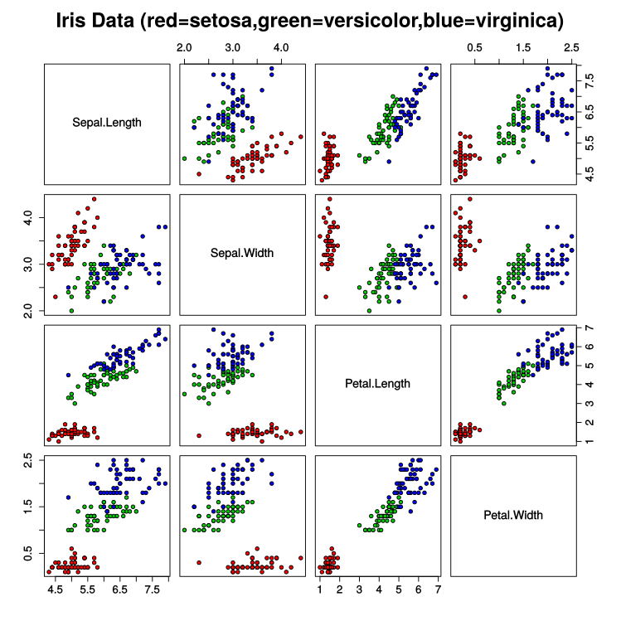
Get the Iris dataset
Example data for clustering
The Iris flower data set is a multivariate data set introduced by the
British statistician and biologist Ronal Fisher in 1936.
You can read more about it on Wikipedia’s page https://en.wikipedia.org/wiki/Iris_flower_data_ set
You can find the .csv file easily; I got it from https://raw.githubusercontent.com/vincentarelbundock/ Rdatasets/master/csv/datasets/iris.csv

Slide 6
Get the Iris dataset
Now, we are ready to load the .csv file into the interpreter using pandas package.
1 # Using pandas
l i b r a r y to l o a d c s v f i l e
2 # i n t o a DataFrame o b j e c t
3 our Data = pd . read_ csv ( " i r i s . c s v " )
4
# Created o b j e c t ‘ our Data ‘ c o n t a i n s
# a funny and famous data s e t o f f l o w e r s .
# At f i r s t , we need to e x p l o r e ,
# what i s i n t h i s data s e t .
# For t h i s , pandas package p r o v i d e s
# s e v e r a l v e r y u s e f u l f u n c t i o n s
4/17

Slide 7
Explore the Iris dataset
Trying useful functions from pandas
The first useful command is head()
It returns first several lines of a dataframe. Very useful to get an idea of what kind of data you have!
1 our Data . head ( )
# Unnamed: 0 Sepal.Length Sepal.Width Petal.Length Petal.Width Species
# 0 | 1 | 5.1 | 3.5 | 1.4 | 0.2 setosa
# 1 | 2 | 4.9 | 3.0 | 1.4 | 0.2 setosa
# 2 | 3 | 4.7 | 3.2 | 1.3 | 0.2 setosa
# 3 | 4 | 4.6 | 3.1 | 1.5 | 0.2 setosa
# 4 | 5 | 5.0 | 3.6 | 1.4 | 0.2 setosa

Slide 8
Explore the Iris dataset
Trying useful functions from pandas
Second command, info() , can give a more precise information on what data types we operate on.
The dataset has 150 entries
Sepal and petal parameters are floating-point numbers
Species is recognized as object type – in fact, this is a text
1 our Data . i n f o ( )
# <class ’pandas.core.frame.DataFrame’> # Int64Index: 150 entries, 0 to 149
# Data columns (total 6 columns):
# Unnamed: 0 # Sepal.Length # Sepal.Width # Petal.Length # Petal.Width
150 non-null int64
150 non-null float64
150 non-null float64
150 non-null float64
150 non-null float64
# Species 150 non-null object
# dtypes: float64(4), int64(1), object(1) # memory usage: 8.2+ KB

Slide 9
Explore the Iris dataset
Trying useful functions from pandas
The last command is more advanced: ourData.describe().
1 our Data . d e s c r i b e ( )
This command gives some statistical information about numeric values in your dataset.
# | Unnamed: 0 | Sepal.Length | Sepal.Width | Petal.Length | Petal.Width
# count | 150.000000 | 150.000000 | 150.000000 | 150.000000 | 150.000000
# mean | 75.500000 | 5.843333 | 3.057333 | 3.758000 | 1.199333
# std | 43.445368 | 0.828066 | 0.435866 | 1.765298 | 0.762238
# min | 1.000000 | 4.300000 | 2.000000 | 1.000000 | 0.100000
# 25% | 38.250000 | 5.100000 | 2.800000 | 1.600000 | 0.300000
# 50% | 75.500000 | 5.800000 | 3.000000 | 4.350000 | 1.300000
# 75% | 112.750000 | 6.400000 | 3.300000 | 5.100000 | 1.800000
# max | 150.000000 | 7.900000 | 4.400000 | 6.900000 | 2.500000
It is useful to understand what is the range of your values.

Slide 10
Explore the Iris dataset
Trying useful functions from pandas
But what about the last column Species?
1 # Get u n i qu e v a l u e s i n the column
2 s p e c i e s = our Data . S p e c i e s . u n i qu e ( )
3
4 p r i n t ( s p e c i e s )
We’ve seen these are textual values. Now, let us see what kinds of values does this column have?
# [’setosa’ ’versicolor’ ’virginica’]
8/17

Slide 11
Draw some plots
Using matlplotlib
Let’s try to plot something!
1 # p l o t d i f f e r e n t s p e c i e s
i n d i f f e r e n t c o l o u r s
2 c o l o r s = [ ’ g ’ , ’ r ’ , ’ b ’ , ’ c ’ , ’m’ , ’ k ’ ]
s p e c i e s _ d i c t = d i c t ( z i p ( s p e c i e s , c o l o r s ) )
p l t . s c a t t e r ( our Data [ ’ S e p a l . Length ’ ]
5
6
7
8
9 # use e i t h e r
, our Data [ ’ S e p a l . Width ’ ]
, c=our Data [ ’ S p e c i e s ’ ]
. a p p l y ( lambda x :
s p e c i e s _ d i c t [ x ] )
)
10 # p l t . show ( ) # to draw on−s c r e e n
11 # or
12 # p l t . s a v e f i g (" f i l e n a m e ") # to s a v e
p i c t u r e
13 p l t . s a v e f i g ( " r e a l −l a b e l s . png " )
In this example I map names of the species onto colors.
Play with this code a little bit changing the columns to plot. This gives you an insight how the data looks like.

Slide 12
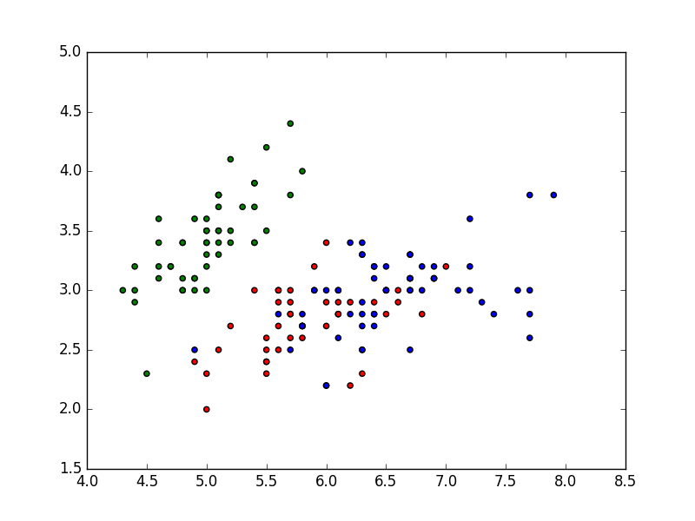
Draw some plots
Using matlplotlib
...And here is how the result looks like
10/17

Slide 13
Prepare data
Split input and labels
1 # Here i s
our data , but w i th o u t s p e c i e s i n f o r m a t i o n
2 our Data No Labels
3 = pd . DataFrame ( our Data
4
5
6
7
8
9
, columns =[ ’ S e p a l . Length ’
, ’ S e p a l . Width ’
, ’ Pe t a l . Length ’
, ’ Pe t a l . Width ’
]
)
Copy the data to a new variable ourDataNoLabels.
We will play like we don’t know the labels and want to estimate them.

Slide 14
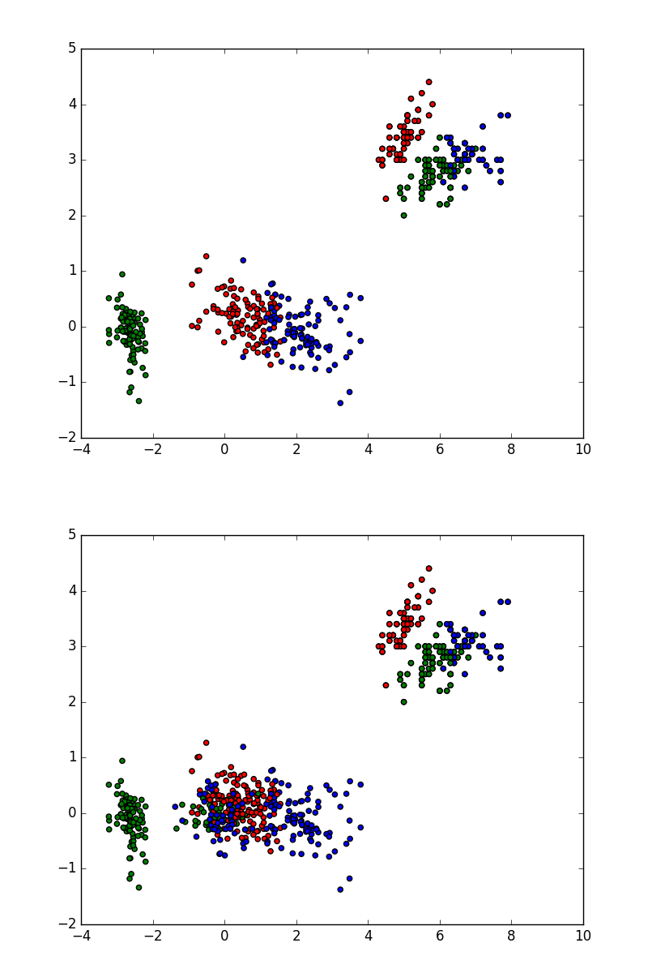
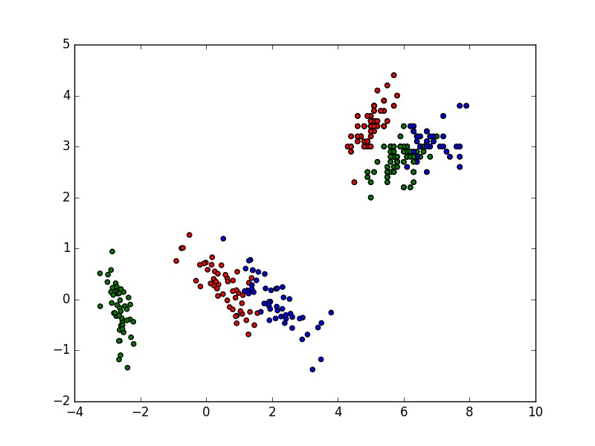
Draw some plots
Using matlplotlib
...And here are the plots
13/17

Slide 15
Principal Component analysis
Using sklearn.decomposition
# Run P r i n c i p a l Component A n a l y s i s
# to get more u n d e r s t a n d i n g how our data l o o k s
our Data Reduced
4 = d e c o m p o s i t i o n
l i k e
This code performs PCA (lines 3-7).
(Most of the code is just to draw three plots).
5
. PCA( n_components=3)
6
. f i t _ t r a n s f o r m ( our Data No Labels )
Principal component transform is a procedure that rotates point space in such a way that points variance is the biggest along X-axis, the second is along Y-axis, and so on.
7 p l t . s c a t t e r ( our Data Reduced [ : , 0 ]
8
9
, our Data Reduced [ : , 1 ]
, c=our Data [ ’ S p e c i e s ’ ]
10
. a p p l y ( lambda x : s p e c i e s _ d i c t [ x ] ) )
11 p l t . s a v e f i g ( " r e a l −pca −1−2. png " )
12 p l t . s c a t t e r ( our Data Reduced [ : , 0 ]
13
The method is simple but very powerful for data exploration. If data have 14 many dimensions (i.e. 50) it is very convenient to look only at 2-5 most 15 significant dimensions. Otherwise visual inspection of the data would be
too difficult.
, our Data Reduced [ : , 2 ]
, c=our Data [ ’ S p e c i e s ’ ]
. a p p l y ( lambda x : s p e c i e s _ d i c t [ x ] ) )
16 p l t . s a v e f i g ( " r e a l −pca −1−3. png " )
17 p l t . s c a t t e r ( our Data Reduced [ : , 1 ]
18
19
, our Data Reduced [ : , 2 ]
, c=our Data [ ’ S p e c i e s ’ ]
20
. a p p l y ( lambda x : s p e c i e s _ d i c t [ x ] ) )
21 p l t . s a v e f i g ( " r e a l −pca −2−3. png " )

Slide 16
Principal Component analysis
Using sklearn.decomposition
# Run P r i n c i p a l Component A n a l y s i s
# to get more u n d e r s t a n d i n g how our data l o o k s
our Data Reduced
4 = d e c o m p o s i t i o n
l i k e
This code performs PCA (lines 3-7).
(Most of the code is just to draw three plots).
5
. PCA( n_components=3)
6
. f i t _ t r a n s f o r m ( our Data No Labels )
Principal component transform is a procedure that rotates point space in such a way that points variance is the biggest along X-axis, the second is along Y-axis, and so on.
7 p l t . s c a t t e r ( our Data Reduced [ : , 0 ]
8
9
, our Data Reduced [ : , 1 ]
, c=our Data [ ’ S p e c i e s ’ ]
10
. a p p l y ( lambda x : s p e c i e s _ d i c t [ x ] ) )
11 p l t . s a v e f i g ( " r e a l −pca −1−2. png " )
12 p l t . s c a t t e r ( our Data Reduced [ : , 0 ]
13
The method is simple but very powerful for data exploration. If data have 14 many dimensions (i.e. 50) it is very convenient to look only at 2-5 most 15 significant dimensions. Otherwise visual inspection of the data would be
too difficult.
, our Data Reduced [ : , 2 ]
, c=our Data [ ’ S p e c i e s ’ ]
. a p p l y ( lambda x : s p e c i e s _ d i c t [ x ] ) )
16 p l t . s a v e f i g ( " r e a l −pca −1−3. png " )
17 p l t . s c a t t e r ( our Data Reduced [ : , 1 ]
18
19
, our Data Reduced [ : , 2 ]
, c=our Data [ ’ S p e c i e s ’ ]
12/17
20
. a p p l y ( lambda x : s p e c i e s _ d i c t [ x ] ) )
21 p l t . s a v e f i g ( " r e a l −pca −2−3. png " )

Slide 17
K-means clustering
Using sklearn.cluster
1 # We know t h a t t h e r e must be 3 d i f f e r e n t
2 #
c l u s t e r s
− s p e c i e s o f f l o w e r s .
3 # So l e t ’ s g i v e t h i s h i n t to the a l g o r i t h m
Finally, we are ready for some clustering!
4 kmeans = c l u s t e r . KMeans ( 3 )
5
. f i t ( np . a r r a y ( our Data No Labels ) )
6 f o u n d L a b e l s
7 = pd . DataFrame ( kmeans . l a b e l s _
8
9
, columns =[ ’K−means c l u s t e r s ’ ] )
10
11 p l t . s c a t t e r ( our Data [ ’ S e p a l . Length ’ ]
12
13
14
, our Data [ ’ S e p a l . Width ’ ]
, c=f o u n d L a b e l s [ ’K−means c l u s t e r s ’ ]
. a p p l y ( lambda x : c o l o r s [ x ] )
15
)
16 p l t . s a v e f i g ( " p r e d i c t e d −l a b e l s . png " )

Slide 18
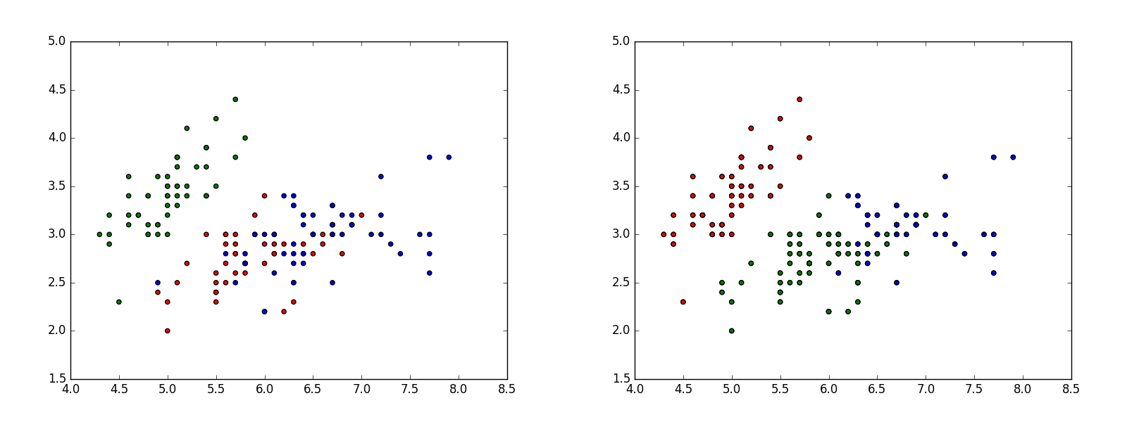
K-means clustering
Using sklearn.cluster
Let’s compare plots...
...would you say this is a good result?
15/17

Slide 19
Assess clustering quality
Using pandas
A very good way to assess performance of an unsupervised clustering algorithm is to look at co-occurrence tables.
1 mat = pd . c r o s s t a b ( our Data [ ’ S p e c i e s ’ ]
2
3
4 p r i n t ( mat )
, f o u n d L a b e l s [ ’K−means c l u s t e r s ’ ]
)
Package pandas provides a special function crosstab() that calculates how many times a value from one column occurs together with a value from another column.
# K-means clusters # Species
# setosa
# versicolor # virginica
0 1 2
0 50 0
48 0 2
14 0 36
So, what would be a conclusion now?

Slide 20
Bonus: DBSCAN
Using sklearn.cluster
This code does everything the same way as KMeans clustering example.
1 dbscan = c l u s t e r . DBSCAN( )
2
. f i t ( np . a r r a y ( our Data No Labels ) )
3 f o u n d L a b e l s [ ’DBSCAN c l u s t e r s ’ ]
4
= pd . DataFrame ( dbscan . l a b e l s _
5
, columns =[ ’DBSCAN c l u s t e r s ’ ] )
6 p l t . s c a t t e r ( our Data [ ’ S e p a l . Length ’ ]
7
8
, our Data [ ’ S e p a l . Width ’ ]
, c=f o u n d L a b e l s [ ’DBSCAN c l u s t e r s ’ ]
Try it! And compare the results. Which algorithm performs better?
9
. a p p l y ( lambda x : c o l o r s [ x ] ) )
10 p l t . s a v e f i g ( " p r e d i c t e d −l a b e l s 2 . png " )
11 mat = pd . c r o s s t a b ( our Data [ ’ S p e c i e s ’ ]
12
13 p r i n t ( mat )
, f o u n d L a b e l s [ ’DBSCAN c l u s t e r s ’ ] )
17/17

